Slide 1
CNN Transfer Learning Models Used on Lung Cancer Nodules Classification
Thomas Butler (vra2cf), Drew Haynes (rbc6wr), Christian Schroeder (dbn5eu)

Slide 2

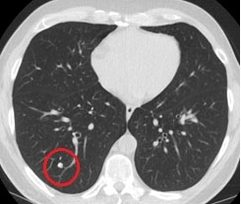
Introduction
Lung cancer was the 6th leading cause of death in 2019 [1]
Lung nodules are abnormal growths inside the lung that are examined by X-ray or CT scan, 95% are not cancerous
Medical Imaging, a subset field of Computer vision, can be employed to identify lesions or cancerous growths within the lungs of patients
Convolutional Neural Network (CNN) are the state of the art computer models used in Medical Imaging
https://towardsdatascience.com/everything-you-ever-wanted-to-know-about-computer-vision-heres-a-look-why-it-s-so-awesome-e8a58dfb641e
https://news.weill.cornell.edu/tags/early-detection

Slide 3
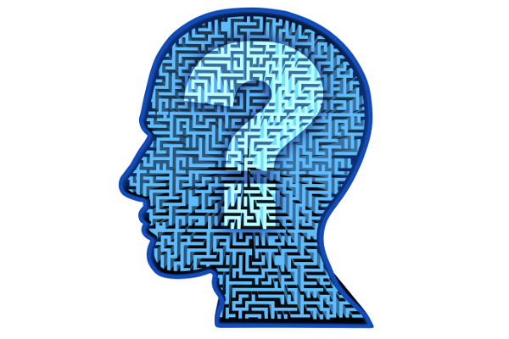
Research Question
Can we develop a CNN model with transfer learning for successfully identifying cancerous lung nodules?
https://unstick.me/wp-content/uploads/2016/12/qualitative-research-question-examples.jpg

Slide 4
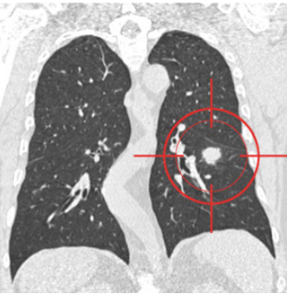
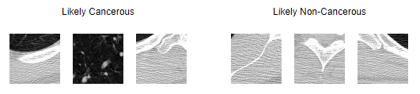
Data
We used the Lung Nodule Analysis 2016 (LUNA16) dataset
Subset of the Lung Image Database Consortium Image Collection (LIDC-IDRI)
Includes 888 CT scans with annotations collected through a two-phase process using 4 radiologists [LUNA16]
Lesions were marked as non-nodule, nodule < 3 mm, and nodule >= 3 mm
A nodule is considered likely cancerous if it was marked as >= 3 mm by 3 out of 4 radiologists
https://luna16.grand-challenge.org/Data/

Slide 5
Project Proposal - Issues
CNN transfer learning requires specific size images
Our current data is CT scans, 2D images of a 3D structure
Would like to put our data into a 3D structure and then into a transfer learning model
Haven’t found any publicly available models of 3D structures that would work with our data
Possible solution?
Create CNN with “piles” of patient scans [6]

Slide 6
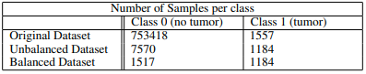
Methodology
Multiple CNN models
Combination of simple and deep CNN
Transfer Learning
Xception
InceptionResNetV2
ResNetV2
Maximize validation metrics (F1-score, precision, and recall)
Test models on balanced and unbalanced datasets

Slide 7
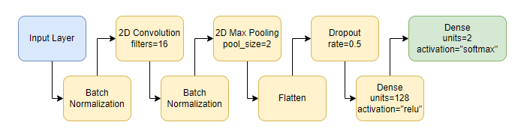
Base Model
Notes:
This is our base model. We normalize the input and convolution layer and run the tumor picture through a convolution layer, pooling those values and run it through a dense layer until we output our class predictions through a softmax layer.

Slide 8
Results
Models | F1-score | Precision | Recall | AUROC
Base | 0.6264 | 0.4618 | 1.0000 | 0.9015
Test | 0.6055 | 0.4375 | 1.0000 | 0.9942
Xception | 0.5997 | 0.4306 | 1.0000 | 1.0000
InceptionResNetV2 | 0.6131 | 0.4481 | 1.0000 | 0.9973
ResNet15V2 | 0.5997 | 0.4306 | 1.0000 | 0.5171
Unbalanced Dataset Models
Models | F1-score | Precision | Recall
Base | 0.2215 | 0.1250 | 1.0000
Test | 0.2282 | 0.1295 | 1.0000
Xception | 0.2439 | 0.1414 | 1.0000
InceptionResNetV2 | 0.2560 | 0.1548 | 0.9524
ResNet15V2 | 0.2352 | 0.1349 | 1.0000
Balanced Dataset Models
Notes:
Here are our metrics on both our Balanced and Unbalanced dataset models. We had 86% no tumor vs 14% tumor on the unbalanced data and 55% no tumor 45% tumor on the balanced data. I want to point out that the InceptionResNetV2 has the best scores out of all the models.

Slide 9
Conclusion
Need more work before applicable to a health setting
Found InceptionResNetV2 to be the most effect of the transfer learning methods
Future work?
Threshold to maximize metrics
Large scale modeling
Early Stopping
Notes:
So as you saw on our last slide, our metrics weren’t great. InceptionResNetV2 was the best transfer learning model.
We want to improve these metrics. Currently our code assumes a threshold of 0.5 for all metrics but we calculated auroc for some of the models and the results looked promising. We hope adding a function that picks a threshold to maximize F1 Score will improve our models metrics overall.
Running the full data on Google Colab was not possible and we lacked the time to make other methods work so we hope we get better results when we run the full data on another platform.
We want to add a early stopping function to our models to reduce overfitting to our models. We lacked the time to implement that.

Slide 10
References
[1] The top 10 causes of death. (n.d.). Retrieved June 27, 2022, from https://www.who.int/news-room/fact- sheets/detail/the-top-10-causes-of-death
[2] Yadav, S. S., Jadhav, S. M. (2019). Deep convolutional neural network based Emedical image classification for disease diagnosis. Journal of Big Data, 6(1), 113. https://doi.org/10.1186/s40537-019-0276-2
[3] Ker, J., Wang, L., Rao, J., Lim, T. (2018). Deep learning applications in medical image analysis. IEEE Access, 6, 9375–9389. https://doi.org/10.1109/ACCESS.2017.2788044
[4] Hinton, G., Sabour, S., Frosst, N. (2018). Matrix capsules with EM routing. https://openreview.net/pdf?id=HJWLfGWRb
[5] Colak, E., Moreland, R. Ghassemi, M. (2021) Five principles for the intelligent use of AI in medical imaging. Intensive Care Med 47, 154–156 (2021). https://doi.org/10.1007/s00134-020-06316-8
[6] Jakimovski, G., Davcev, D. (2018). Lung cancer medical image recognition using Deep Neural Net- works. 2018 Thirteenth International Conference on Digital Information Management (ICDIM), 1–5. https://doi.org/10.1109/ICDIM.2018.8847136
Notes:
Here are our references.

Slide 11
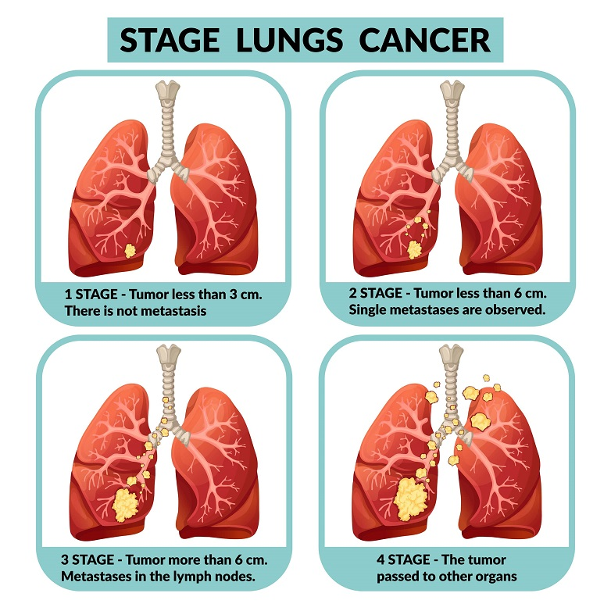
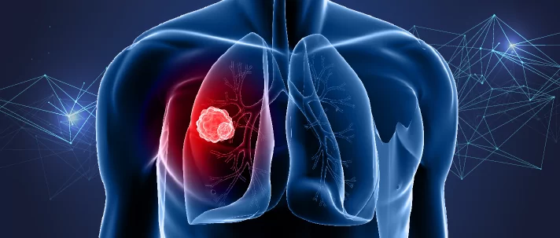
Thank you for your time!
https://www.wcrf.org/wp-content/uploads/2021/05/Cancer-Trends-Lung-data.png
https://www.narayanahealth.org/sites/default/files/pillar-page-static/lung-cancer-img2_lung.jpg
Notes:
Thank you for your time watching this video! Any questions?

Slide 12
Backup

Slide 13
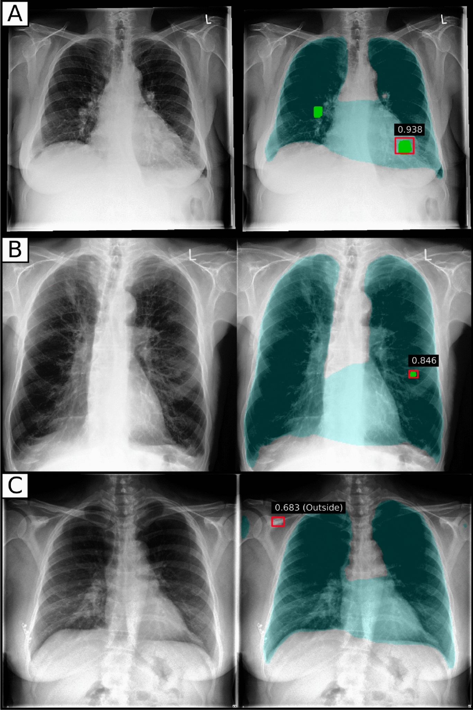
Literature Review
Researched the application of deep learning through CNN and transfer learning in the context of lung cancer diagnostics and medical imaging
Deep learning networks have had the most success in medical imaging so far, and the best networks are convolutional neural networks (CNN) [2]
Current methods show CNN with transfer learning using InceptionV3 can reach an accuracy of 96.6% [2]
https://media.springernature.com/full/springer-static/image/art%3A10.1038%2Fs41598-020-69789-z/MediaObjects/41598_2020_69789_Fig1_HTML.jpg

Slide 14
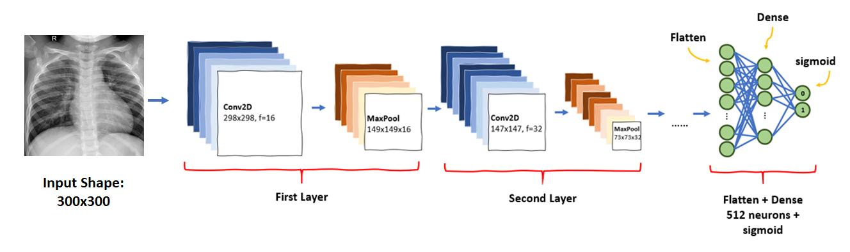
Literature Review - Current and Future Methods
Computer aided medical imaging has gone through 2 major methods
Feature transform with SIFT and classify with SVM
CNN
CNN with transfer learning is the most successful model so far
The next promising method is capsule neural networks (CapsNets)
Invented in 2017 and needs more time to explore best practices [2]
https://miro.medium.com/max/1838/1*18A5bLKeQKCRuOIT17pT8A.png

Slide 15
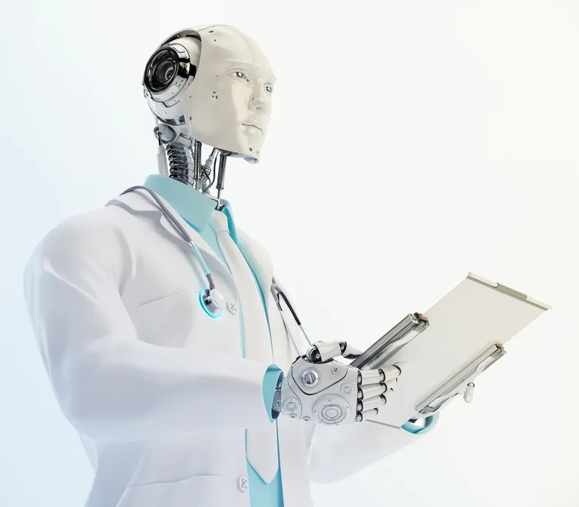
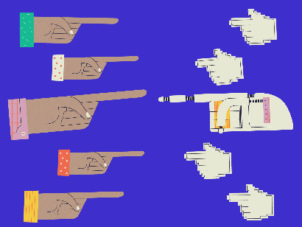
Literature Review - Controversy
ML in medical imaging gaining popularity brings up questions on public reception and responsibility
Would patients trust the results if they knew they were determined by a computer?
Who is responsible for a misdiagnosis? The doctor or the AI?
Do AI models need malpractice insurance?
Could overly trusting AI lead to error-prone behavior? [5]
https://cms.qz.com/wp-content/uploads/2018/08/legal-culpability-v4.gif?quality=75&strip=all&w=410&h=308
https://images.theconversation.com/files/195813/original/file-20171122-6031-3egklp.jpg?ixlib=rb-1.1.0&q=45&auto=format&w=754&fit=clip

Slide 16
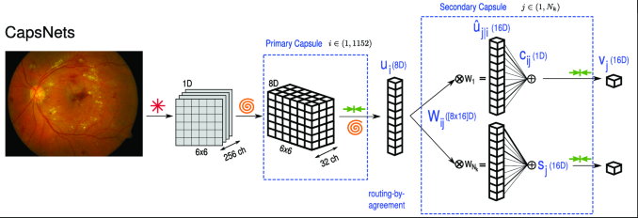
Literature Review - Future Work, CapsNets
CapsNets is a newer type of architecture that could replace CNN
Always has equivariance
More likely to classify a crowded picture
Requires less training data
More interpretable
But…
Slower to train
New and a state of the art use case has not been developed yet
More work should be done on CapsNets application to image segmentation and object detection in medical imaging [4]
https://media.springernature.com/lw685/springer-static/image/chp%3A10.1007%2F978-3-030-01364-6_17/MediaObjects/474216_1_En_17_Fig1_HTML.png

Slide 17
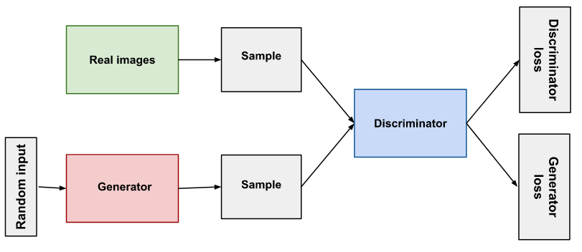
Literature Review - Future Work, GANs
Generative Adversarial Networks (GANs)
Two simultaneously-trained models competing against each other
Can be used to generate higher quality CT scans from MRI images
avoiding the need to expose a patient to ionizing radiation
Has been done already for brain images to improve image quality [3]
https://developers.google.com/machine-learning/gan/gan_structure

Slide 18
Project Proposal - Research Question
Can we improve the accuracy of a CNN model with transfer learning by incorporating malignancy scores?
https://unstick.me/wp-content/uploads/2016/12/qualitative-research-question-examples.jpg

Slide 19
Project Proposal - Data
We plan to use a subset of the Lung Image Database Consortium Image Collection (LIDC-IDRI)
Lesions were marked as non-nodule, nodule < 3 mm, and nodule ≥ 3 mm
A nodule is considered likely cancerous if it was marked as ≥ 3 mm by 3 out of 4 radiologists
Data also includes a malignancy score, the number of cancerous nodules out of all nodules found
https://luna16.grand-challenge.org/Data/

Slide 20
Project Proposal - Methodology
CNN with transfer learning to classify lung nodules as cancerous or not
Intend to explore many different CNN transfer learning models
Data augmentation to flip, crop, scale and rotate data to increase our amount of data and prevent overfitting during training
Subset the data into proper balanced classes to classify on malignancy score and not just if a nodule is malignant
Input of CT scans and output stating if there is cancer and the severity
The model will be evaluated on accuracy
Analyze if sensitivity or specificity is a better option

Slide 21
Project Proposal - Example Model

